Slide 1

HR Analytics Capstone Project
Members:
Ashish Jaiswal
Bhargav
Naga Lakshmi
Iqbal Singh
Vaidehi Buldeo

Slide 2
Agenda
Objective
Data Understanding
Data Pre Processing
EDA
Feature engineering
Modeling
Termination Dataset
Comparison
Conclusion

Slide 3



Objective
Identify factors influencing attrition
Predict possible attritions
Identify possible ways to retain high performers

Slide 4
Data Understanding
Services based dataset
Target Variable – Current Status has 5 categories Active, New Joiners, Sabbatical, Secondment, Resigned
Understanding
 | Rows | Columns
Staff Utilization 2016-17 | 789 | 115
Staff Utilization 2017-18 | 973 | 115
Termination 15-18 | 293 | 9
Merged Dataset
 | Rows | Columns
Merged (Staff utilization 16-18) | 1111 | 43

Slide 5
Merging
Step 1 : The employee no (Primary key) that are present only in 16-17 data needs to be copied as is because we do not have any additional details of them in 17-18. Then to make it uniform we have added empty fields for: Total Hours, Total Available Hours, Work Hours, Leave Hours, Training Hours, BD Hours, NC Hours, Utilization% for Apr 17 – Mar 18
Staff
16- 17
(138)
Staff
17-18
(322)
Staff in Both
(651)
Step 2 : The employee no (Primary key) that are present only in 17-18 data also needs to be copied as is because we do not have any additional details of them in 16-17. Then to make it uniform we have added empty fields for: Total Hours, Total Available Hours, Work Hours, Leave Hours, Training Hours, BD Hours, NC Hours, Utilization% for Apr 16 – Mar 17
Step 3 :Now that the fields are finalized, for the data that is present in both the files we have taken the Profit Center, Employee Name, Employee Position, Employee Location, People Group, Employee Category, Supervisor name, Join Date, Current Status, Termination Date from 17-18 file as it would have the latest updated information and the remaining fields from corresponding files
Step 4 :For the final and most important step we have aggregated the hours data for the entire period Apr 16 – Mar 18 and calculated the Total Hours, Total Available Hours, Work Hour, Leave Hours ,Training Hours, BD Hours, NC Hours, Utilization% using the appropriate formulae.

Slide 6
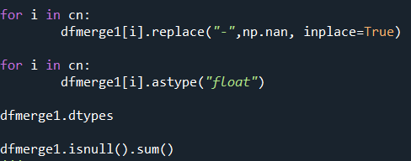
Data Pre-Processing
Replacing missing values(‘-’) to ‘nan’ values – processed this in python for univariate analysis
Changing data type from “object” to “float” for April16 utilization to March 18 Utilization – processed this in python for univariate analysis

Slide 7
Data Pre-Processing
Current Status
(Target Variable)
Active
Sabbatical
New Joiner
Secondment
Resigned
Merging
Resigned
Active

Slide 8
Exploratory Data Analysis
Termination Dataset
Univariate Analysis
Bivariate Analysis
Multivariate Analysis

Slide 9
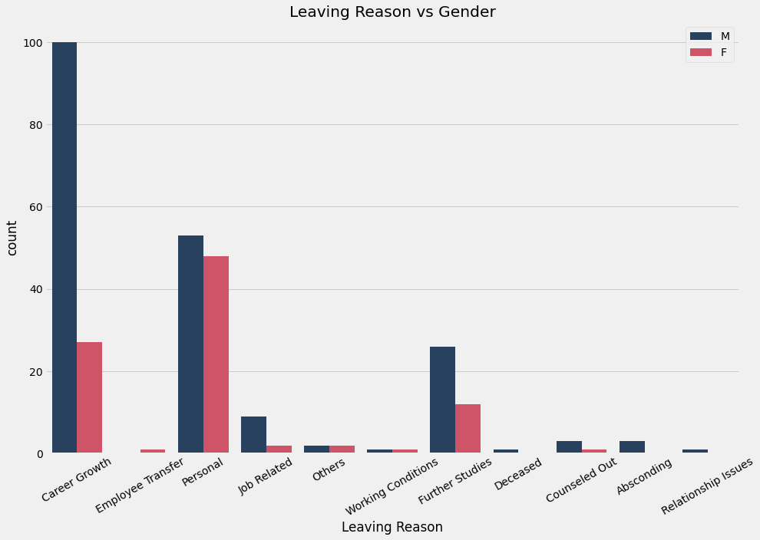
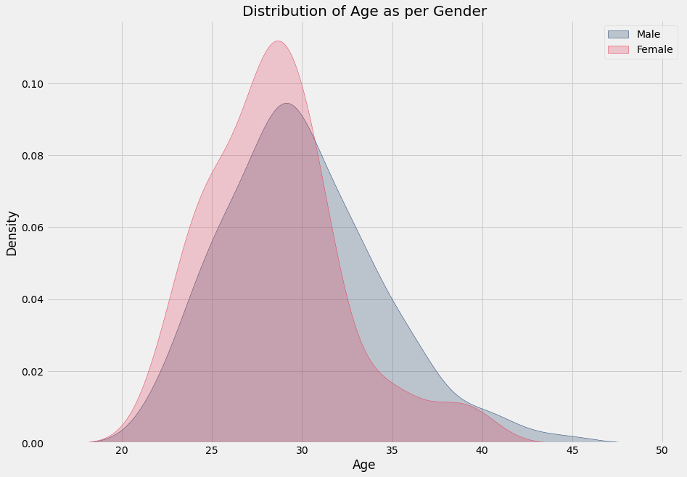
Termination Dataset
Total Termination - 293
Leaving Reasons
Career Growth | 127
Personal Reason | 101
Others | 65
Created new column – Age – to know the age group leaving the organization

Slide 10
Univariate Analysis
Performed this to understand the data well on each variable basis
Techniques used – Count plot, Box Plot and Histogram
Missing Values
Termination Date : 828
Utilization% - 4
Response Variable
Active :834
Resigned: 277
Outliers
Leave Hrs
BD Hrs
NC Hrs
Month-wise Utilization

Slide 11
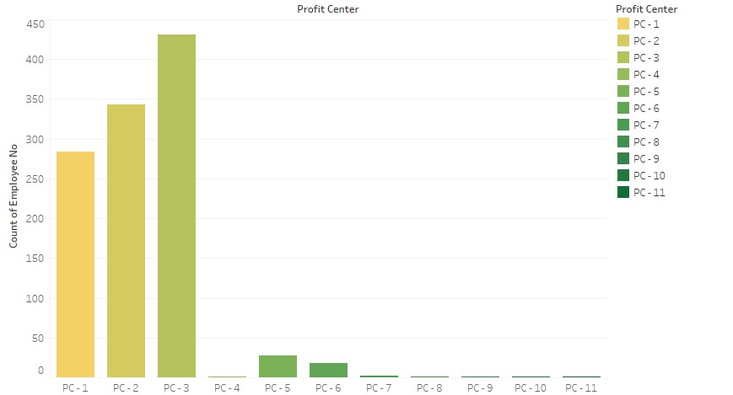
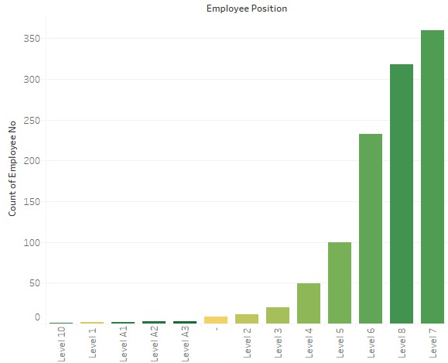
Univariate Analysis
Level 6,7 and 8 has maximum number of employees
Profit center 1, 2 and 3 has the maximum number of employees

Slide 12
Bivariate Analysis
Current Status
Variable | Observation | Hypothesis Testing | Reason | Variable Selection
Profit Centre | Proportions of people resigning from PC-5 and PC-6 is more PC-1, PC-2 & PC-3 has more employees compared to other centers combined | ChiSquare | Interesting observation, PC-10, PC-5, PC-6 & PC-7 are inactive as all the employees from these centers already resigned, we can club these as inactive profit centers to make our model less expensive. | Accepted
Emp Position | From the plots we observed that levels 6, 7 & 8 has the number most of employees. | ChiSquare | level 10 has no active employees. | Accepted
Emp Location | 1- Location 3, 7 & 1 has the most count of employees compared to other locations combined. 2- Proportion of employees resigning at location 3, 7 & 2 is more 3- most employees resigned at location 3 4- location 1 has the most new joiners compared to other locations combined. | ChiSquare | 1- 27% of the employees out of total 299 employees at location 7 resigned 2- 35% of the employees out of total 48 employees at location resigned | Rejected
People group | - | - | Rejecting the variable as Data is more dominant towards 'Client Service Staff' by 99% | Rejected
Emp Category | - | - | It is quite similar to dependent variable, hence we are not considering it for model building | Rejected
Supervisor Name | there are total 152 different supervisors, it will be hard to plot all of them so instead, will create two filters, one of all active employees and one of all resigned employees and then check the supervisor with percentage of resignation under each! | - | Observation shown in plots for better understanding | Accepted
To identify the how the variable is affecting the response variable

Slide 13
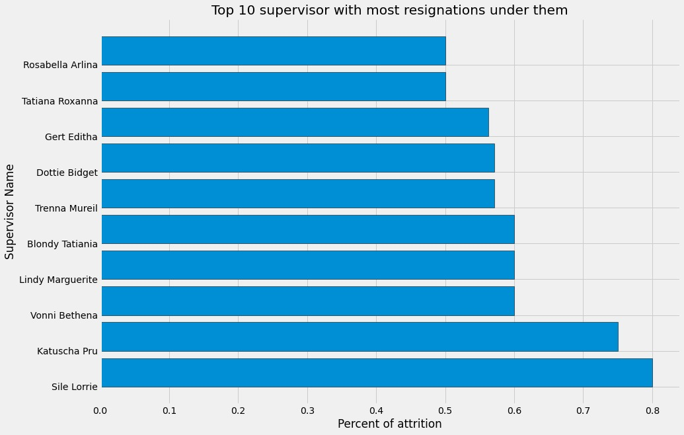
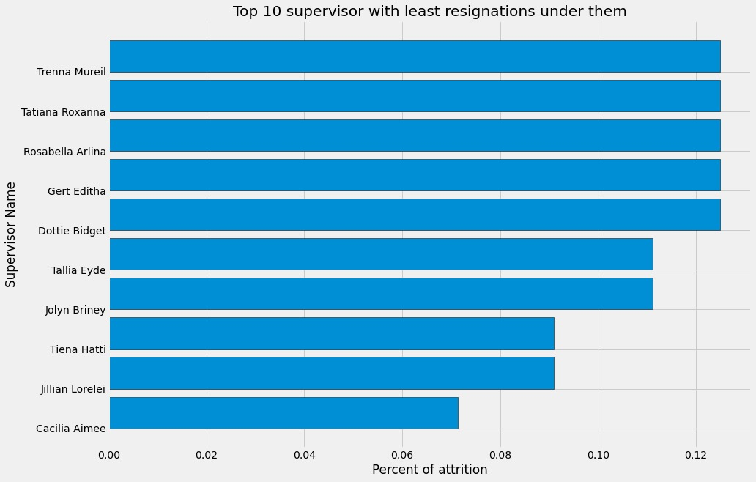
Supervisor Plot
Maximum % of resignations under a supervisor
Least % of resignations under a supervisor

Slide 14
Bivariate Analysis
Variable | Observation | Hypothesis Testing | Reason | Variable Selection
Total hrs | Distribution of Total chargeable hours available is right skewed whereas it is left skewed for all the active employees | T-test | Correlated with total available hrs | Rejected
Total Avaible hrs | Distribution for Resigned employees is right skewed whereas it is left skewed for active employees! | T-test | P-value <0.05 | Accepted
Work hrs | Distribution of work hours for resigned employees is right skewed, indicating less hours of work. whereas for active employees it in little bit uniform indicating probability of employees working less or more hours is same | T-test | P-value <0.05 | Accepted
Leave hrs | 1- Resigned employees have taken less number of leaves compared to active employees | T-test | P-value <0.05 | Accepted
Training hrs | 1- Distribution for both resigned and active employees in right skewed 2- active employees have been in training more than resigned employees | T-test | P-value <0.05 | Accepted
BD Hrs | 1- Distribution for both resigned and active employees is gaussian with outliers 2- both the active and resigned employees devoted similar hours to business developtment | T-test | P-value <0.05 | Accepted
NC Hrs | 1- Distribution for both resigned and active employees is gaussian (if outliers are removed) 2- both the employees have similar Non chargeable hours | T-test | P-value <0.05 | Accepted
Utilization % | 1- Distribution for both resigned and active employees is quite similar(extreme outliers are present) 2- both employees have similar yearly Utilization | T-test | The column resembles work hrs/Total available hrs | Rejected

Slide 15
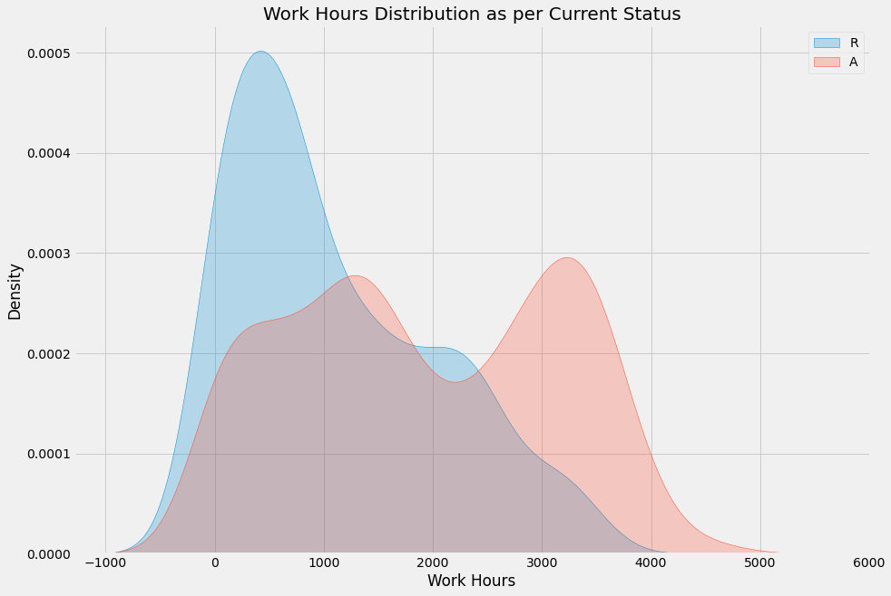
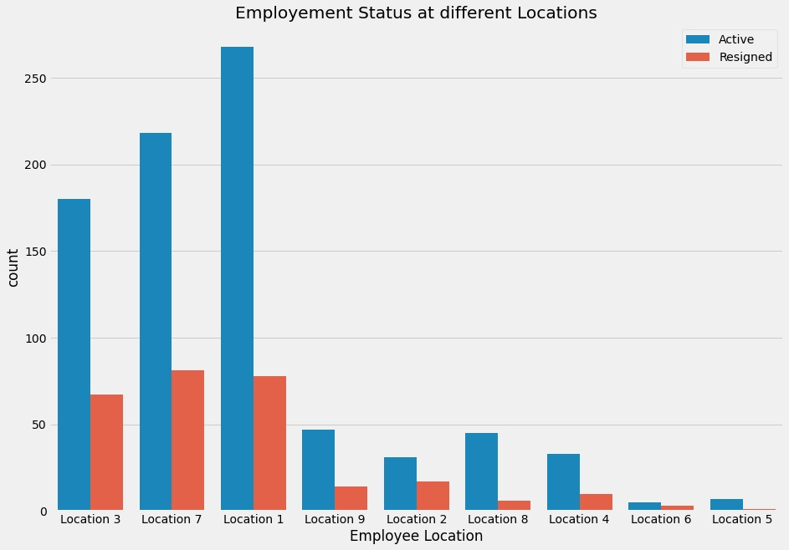
Bivariate Analysis
On Average Resigned employees have less Work Hours than the Active employees
L3,L7 & L1 has maximum number Active and Resigned employees
35% of total employees at location 2 resigned followed by 27% at location 7 and location 3

Slide 16
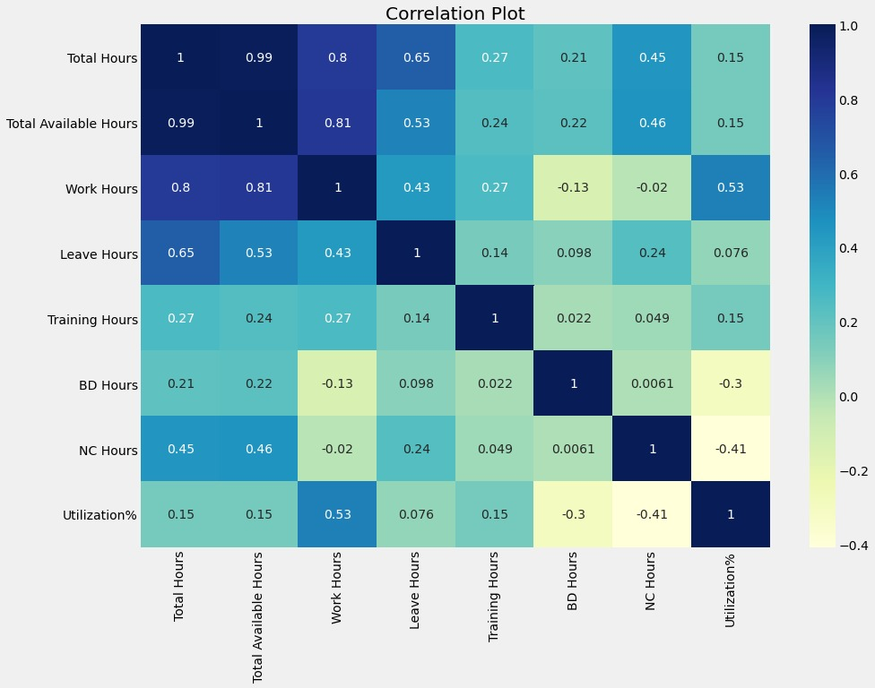
Multivariate Analysis
Total Hours and to Available Hours
are perfectly correlated with each other
Work Hours has correlation value of around 0.8 with Total Hours and Total Available hours

Slide 17
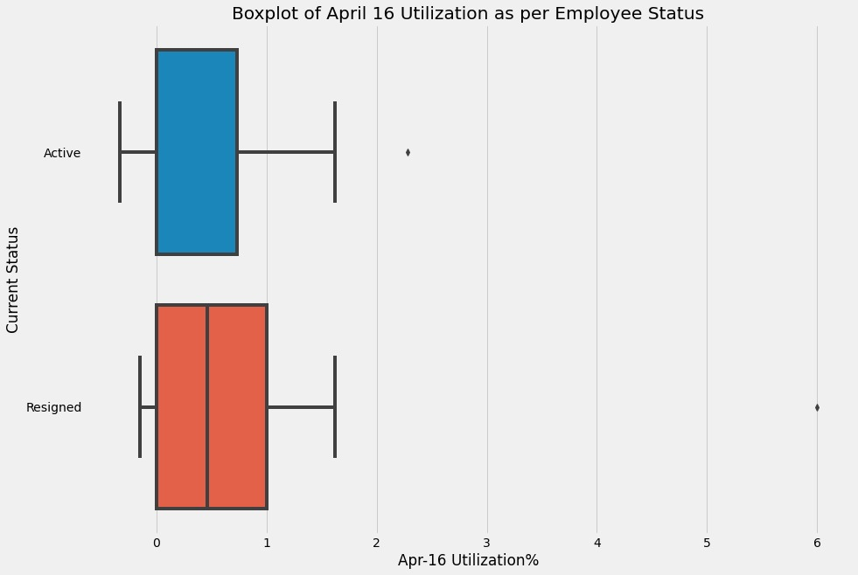
Multivariate Analysis
Variable | Observation | Hypothesis Testing | Reason | Variable Selection
Utilization% from April16 to June16 | Active and resigned employees are equally distributed | T-test | P-value <0.05 | Accepted
Utilization% from July16 to Feb17 | - | T-test | P-value >0.05 | Rejected
Utilization% from March17 to March18 | Active and resigned employees are equally distributed | T-test | P-value <0.05 | Accepted

Slide 18
Feature Engineering
Replacing Missing Values
Employee Position(9) – replaced by Mode category
Supervisor name(16) – created a new category (no supervisor)
Monthly Utilization% ( “-” Replaced with 0)
Created new feature named Tenure – to know how many years the employee was with the firm

Slide 19
Feature Engineering
From Staff Utilization July16 to Feb 17 month wise utilization% was dropped as their statistical test p-values were more than 0.05
Yearly utilization is not considered as will take total available hrs. and work hrs. in our model
Month wise Total hrs , BD hrs, NC hrs are dropped as we have considered month wise utilization

Slide 20
Feature Engineering
Label Encoding
(Categorical Variable)
Emp Position
Profit center
Supervisor Name

Slide 21
Modeling and Variable Selection
Profit Centre
Month Wise Utilization
Employee Position
Tenure
Supervisor name
Variables used
Current Status
Total Available Hours
Training Hours
Work Hours
Leave Hours

Slide 22
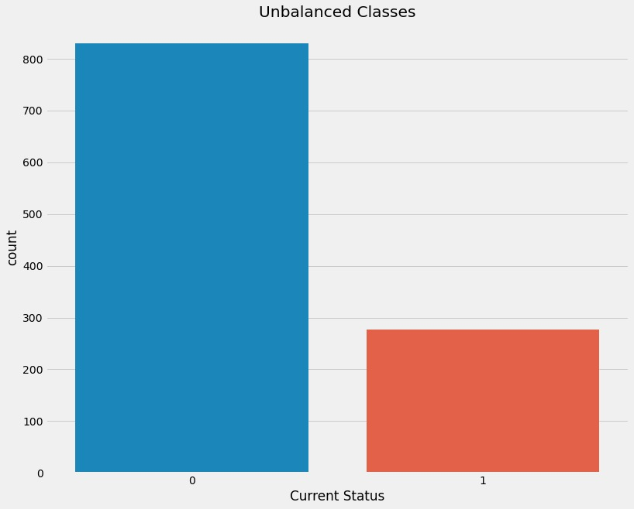
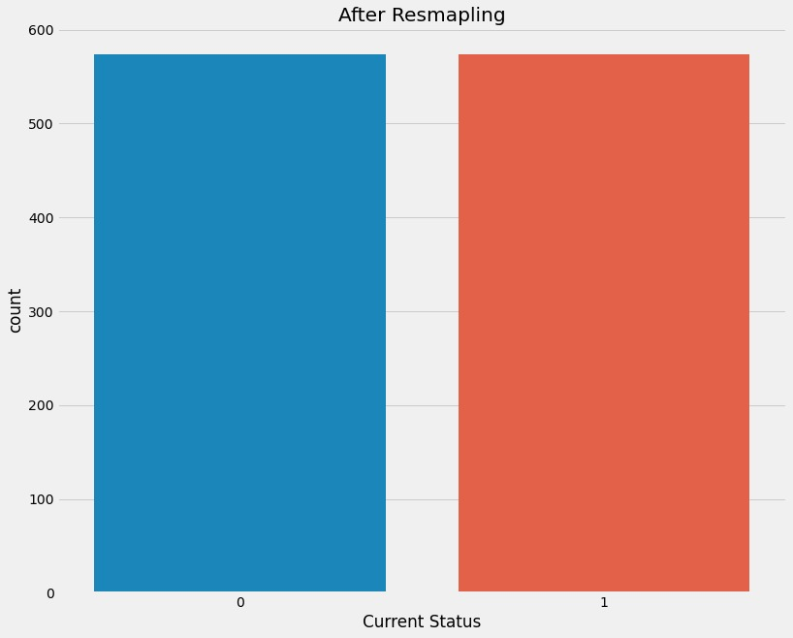
Balancing of Target Variable
The target variable was unbalanced which may have given us good accuracy but it would have been biased towards majority class
After
Before
So we balanced the classes in the target variable by over sampling method from SMOTE
Target Variable was balanced only in Training dataset to keep the model unbiased towards unseen data

Slide 23
Logistic Regression
Scaling continuous variables
Splitting of data in train and test
Applying SMOTE for balancing the data
Accuracy | Train Dataset | Test Dataset
With SMOTE | 0.926 | 0.912

Slide 24
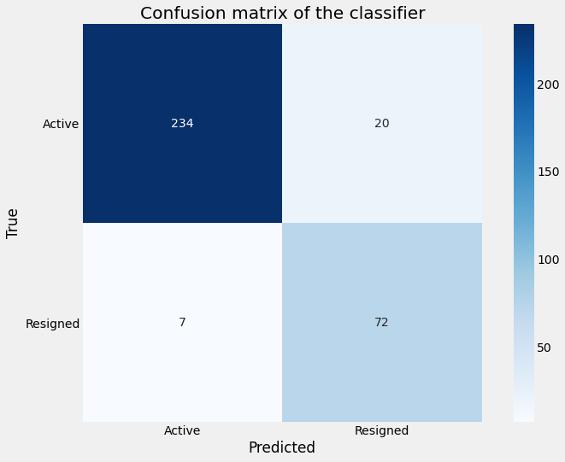
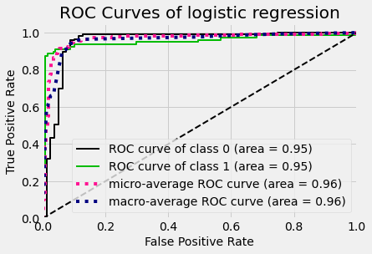
Logistic Regression
Train Dataset
 | 0 | 1
Precision | 0.91 | 0.94
Recall | 0.94 | 0.91
F1 Score | 0.93 | 0.93
Test Dataset
 | 0 | 1
Precision | 0.97 | 0.78
Recall | 0.92 | 0.91
F1 Score | 0.95 | 0.84

Slide 25
Decision Tree
For classification model – checked for entropy Gini Index
Accuracy | Train Dataset | Test Dataset
With SMOTE | 0.971 | 0.963

Slide 26

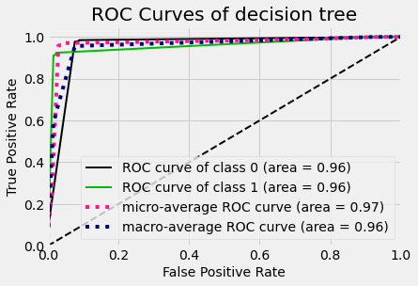
Decision Tree
Train Dataset
 | 0 | 1
Precision | 0.97 | 0.98
Recall | 0.98 | 0.97
F1 Score | 0.97 | 0.97
Test Dataset
 | 0 | 1
Precision | 0.98 | 0.92
Recall | 0.98 | 0.92
F1 Score | 0.98 | 0.92

Slide 27
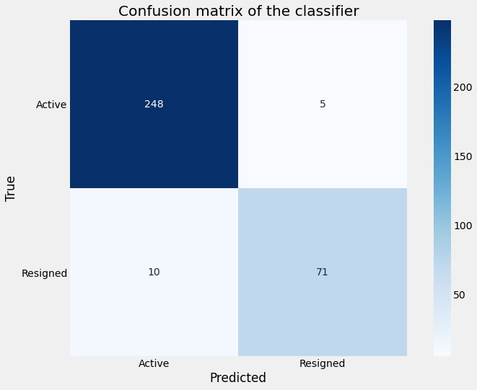
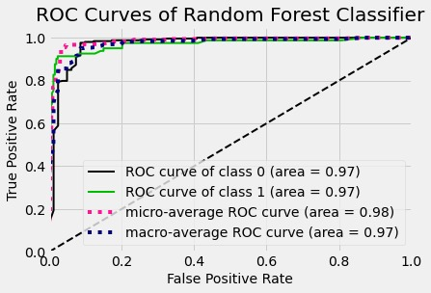
Random Forest
Train Dataset
 | 0 | 1
Precision | 1.0 | 1.0
Recall | 1.0 | 1.0
F1 Score | 1.0 | 1.0
Test Dataset
 | 0 | 1
Precision | 0.97 | 0.93
Recall | 0.98 | 0.90
F1 Score | 0.97 | 0.91

Slide 28
Model Comparison
 | Logistic Regression |  | Decision Tree |  | Random Forest
Accuracy | 0.912 |  | 0.963 |  | 0.961
 | 0 | 1 | 0 | 1 | 0 | 1
Precision | 0.97 | 0.78 | 0.98 | 0.92 | 0.97 | 0.93
Recall | 0.92 | 0.91 | 0.98 | 0.92 | 0.98 | 0.90
F1 Score | 0.95 | 0.84 | 0.98 | 0.92 | 0.97 | 0.91
No. of features used | 26 |  | 26 |  | 26
We are selecting Random Forest as our final model because it is faster than decision tree and preforms better
Time for performing Decision tree was >1min while Random forest took 10 sec
It builds 500 decision trees on samples and takes their majority vote for classification

Slide 29
Conclusion I
According to the Random forest model prediction 168 out of 834 (i.e. 20%) of the active employees may resign
Complete list of Attrition
163 people were promoted in last fiscal year.
29 out of 163 people promoted may resign.
Employee No | Employee Name | Promotion | Prob_Attrition
5 | Idalina Lauraine | NO | Yes
7 | Irene Candis | NO | Yes
18 | Marina Garnette | NO | Yes
24 | Rina Debee | NO | Yes
26 | Marney Anderea | NO | Yes
30 | Kristina Alleen | NO | Yes

Slide 30

Conclusion II
High performers can be retained by offering:
Yearly Bonus or Salary Hike (performance incentives)
Recognition and Rewards (non monetary)
Management interventions with supervisors and department heads.

Slide 31


